Slide 1

Intrusion Detection System in Mobile Phone Systems Using Deep Belief Network (DBN)
MLA0403 – Deep Learning
Students Names
Kothakota Rakesh
Shaik Rafiqhuddin
M Akash A Santhosh
SIMATS Engineering
Guided By
Dr.A.M.Arul Raj
Professor
SIMATS Engineering
Notes:
1
1

Slide 2




Abstract
Mobile devices are increasingly targeted by cyber attacks.
A Deep Belief Network (DBN) learns patterns from network traffic.
The system detects malicious activities with high accuracy.
Improves mobile network security through intelligent intrusion detection.
Cyberattacks Rising
Mobile devices face growing threats
DBN Learns Patterns
Learns from real network traffic
High Accuracy
Detects malicious activity reliably
Stronger Security
Smarter protection for mobile networks

Slide 3


Aim and Objective
To develop an intelligent Intrusion Detection System (IDS) for mobile phone networks using a Deep Belief Network (DBN).
To improve the accuracy of detecting cyberattacks while reducing false alarms and enhancing mobile network security.
Collect and preprocess mobile network traffic data for model training.
Train a Deep Belief Network (DBN) to distinguish between normal and malicious network behaviour.
Detect and classify different types of network intrusions with high accuracy and low false alarm rates.
Generate real-time security alerts to help protect mobile devices and networks from cyber threats.

Slide 4

Introduction
Mobile phones have become an essential part of daily life, making them a common target for cyber attacks such as malware, phishing, and unauthorized access.
Traditional intrusion detection systems often fail to detect new and sophisticated attacks due to their reliance on predefined signatures.
Deep Learning techniques, especially Deep Belief Networks (DBN), can automatically learn complex patterns from network traffic and identify both known and unknown intrusions.
This project proposes a DBN-based Intrusion Detection System to improve the accuracy, efficiency, and reliability of mobile network security through intelligent attack detection.

Slide 5
Literature Review & Requirement Analysis
S.No | Year of Publication | Author | Title of the Journal / book | Methodology used | Algorithm used | Key Findings
1 | 2021 | Sharma et al. | Mobile Network Intrusion Detection | Deep Learning | CNN | High detection accuracy, reduced false positives
2 | 2022 | Wang et al. | Intelligent IDS for Mobile Networks | Feature Extraction + Classification | DBN | Better detection of unknown attacks
3 | 2023 | Kumar et al. | Deep Learning for Network Security | Data Preprocessing & Training | DBN | Improved accuracy and faster intrusion detection

Slide 6




Problem Statement
Increasing cyber threats targeting mobile phone networks.
Traditional intrusion detection systems have low accuracy against unknown attacks.
Large volumes of network traffic make real-time threat detection difficult.
Need a Deep Belief Network (DBN)-based Intrusion Detection System for accurate, intelligent, and real-time attack detection.
Growing Threats
More cyberattacks on mobile networks
Low Accuracy
Existing systems miss unknown attacks
Real-Time Challenge
High traffic volume slows detection
Smarter IDS Needed
An intelligent, adaptive solution

Slide 7




Existing System
Signature-based Intrusion Detection Systems (IDS) are widely used.
Detect only known attacks using predefined attack signatures.
Low detection accuracy for new or zero-day attacks.
High false positive and false negative rates in mobile networks.
Limited real-time analysis and adaptability to evolving cyber threats.
Signature-Based
Matches known attack patterns
Known Attacks Caught
Works for previously seen threats
Zero-Day Blind Spot
Misses new, unseen attacks
High False Alarms
Frequent false positives/negatives

Slide 8

Proposed System
Develop a Deep Belief Network (DBN)-based Intrusion Detection System for mobile phone networks.
Collect and preprocess mobile network traffic for effective feature learning.
Detect and classify known and unknown cyber attacks with high accuracy.
Generate real-time intrusion alerts to enhance network security.
Improve detection performance while reducing false positives and false negatives.
Preprocessing
Clean, normalized traffic data
DBN Learning
Learns normal vs. malicious patterns
Accurate Detection
Classifies known & unknown attacks
Real-Time Alerts
Immediate notification on threats

Slide 9
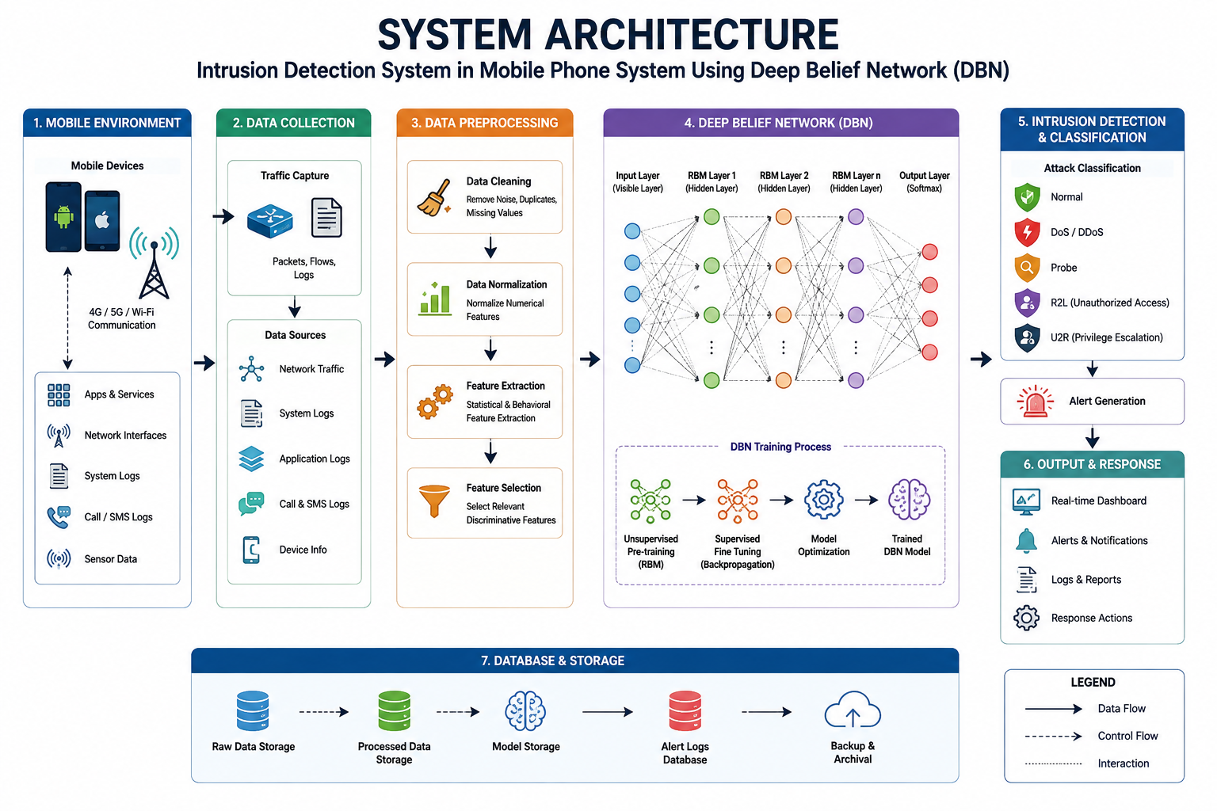

Slide 10



System Architecture – Detailed Flow
Mobile Network Traffic
Raw traffic capture
Preprocessing
Clean & normalize
Feature Extraction
Select key attributes
DBN Model
Stacked RBM layers
Classification
Normal vs. attack
Real-Time Alert
Notify & log event
Inside the DBN – Layer-Wise Training
RBM Layer 1
Learns low-level traffic features
RBM Layer 2
Learns mid-level representations
RBM Layer 3
Learns high-level abstractions
Softmax Output
Final normal / attack decision

Slide 11


Sustainable Development Goal (SDG) Implementation
SDG 9 – Industry, Innovation and Infrastructure
Why SDG 9?
Your project uses Artificial Intelligence (Deep Learning) to strengthen digital infrastructure and improve cybersecurity in mobile networks.

Slide 12
Proposed Methodology and Algorithm
Methodology
Collect mobile network traffic dataset (e.g., NSL-KDD or CICIDS2017).
Preprocess data by cleaning, normalizing, and selecting relevant features.
Train the Deep Belief Network (DBN) to learn normal and malicious traffic patterns.
Detect and classify intrusions, then generate real-time security alerts.
Algorithm - Deep Belief Network (DBN)

Slide 13
Module 1: Data Acquisition & Preprocessing
OBJECTIVE
Collect and prepare mobile network traffic data so it is clean, consistent, and ready to train the Deep Belief Network.
KEY TASKS
Collect network traffic data from NSL-KDD / CICIDS2017 datasets and mobile traffic logs
Clean the data: handle missing values, remove duplicates and noisy records
Normalize numeric features and encode categorical attributes
Split the dataset into training, validation, and test sets
MODULE 1

Slide 14
Module 1: Data Acquisition & Preprocessing – Techniques & Tools
TECHNIQUES USED
Min-Max normalization and Z-score standardization
One-hot encoding for categorical attributes
Stratified sampling for a balanced train-test split
MODULE 1
TOOLS
Python, Pandas, NumPy, Scikit-learn
OUTPUT
A clean, structured dataset ready for feature extraction

Slide 15
Module 2: Feature Extraction & Selection
OBJECTIVE
Identify the most relevant traffic attributes that best distinguish normal behaviour from malicious activity.
KEY TASKS
Extract statistical and flow-based features such as packet size, duration, and protocol type
Reduce dimensionality by removing redundant or correlated attributes
Rank features by their relevance to attack detection
Prepare the final feature set for the DBN input layer
MODULE 2

Slide 16
Module 2: Feature Extraction & Selection – Techniques & Tools
TECHNIQUES USED
Principal Component Analysis (PCA) for dimensionality reduction
Correlation-based feature selection
Information Gain and Chi-square ranking
MODULE 2
TOOLS
Scikit-learn, Pandas, NumPy
OUTPUT
Optimized, low-dimensional feature vectors for model training

Slide 17
Module 3: DBN Architecture Design & Training
OBJECTIVE
Design and train a Deep Belief Network that learns the underlying patterns of normal and malicious network traffic.
KEY TASKS
Stack multiple Restricted Boltzmann Machines (RBMs) to form the DBN
Perform greedy layer-wise unsupervised pre-training
Fine-tune the network end-to-end with supervised backpropagation
Tune hyperparameters: number of layers, learning rate, and epochs
MODULE 3

Slide 18
Module 3: DBN Architecture Design & Training – Techniques & Tools
TECHNIQUES USED
Contrastive Divergence for RBM pre-training
Backpropagation with a softmax output layer
Dropout and early stopping to prevent overfitting
MODULE 3
TOOLS
TensorFlow / Keras, Python
OUTPUT
A trained DBN model ready for intrusion classification

Slide 19
Module 4: Intrusion Detection & Classification
OBJECTIVE
Use the trained DBN to classify live network traffic as normal or malicious in real time.
KEY TASKS
Feed preprocessed traffic samples into the trained DBN
Classify traffic into normal or attack categories
Identify specific attack types such as DoS, Probe, R2L, and U2R
Evaluate classification confidence scores for each prediction
MODULE 4

Slide 20
Module 4: Intrusion Detection & Classification – Techniques & Tools
TECHNIQUES USED
Softmax-based multi-class classification
Confusion matrix analysis to study error patterns
Threshold tuning to reduce false alarms
MODULE 4
TOOLS
TensorFlow / Keras, Scikit-learn metrics
OUTPUT
Real-time, labelled traffic classification results

Slide 21
Module 5: Real-Time Alert Generation & Evaluation
OBJECTIVE
Turn detections into real-time security alerts and rigorously evaluate the system's overall performance.
KEY TASKS
Trigger real-time alerts whenever malicious traffic is detected
Log and report intrusion events for network administrators
Evaluate the model using standard performance metrics
Benchmark results against existing intrusion detection approaches
MODULE 5

Slide 22
Module 5: Real-Time Alert Generation & Evaluation – Techniques & Tools
TECHNIQUES USED
Accuracy, Precision, Recall, and F1-score evaluation
ROC curve and AUC analysis
Real-time alert dashboard and notification system
MODULE 5
TOOLS
Python, Matplotlib / Seaborn, Flask
OUTPUT
A validated, deployable intrusion detection system

Slide 23
Conclusion
Developed a Deep Belief Network (DBN)-based Intrusion Detection System for mobile phone network security.
Improved detection of both known and unknown cyber attacks through deep learning.
Enhanced network security with real-time intrusion detection and alert generation.
Demonstrated the potential of AI and Deep Learning to provide accurate, reliable, and scalable cybersecurity solutions for mobile networks.

Slide 24
References
Ian Goodfellow, Yoshua Bengio, and Aaron Courville, Deep Learning, MIT Press, Cambridge, Massachusetts, 1st Edition, 2016. Deep Learning fundamentals, Neural Networks, Deep Belief Networks (DBN), model training, and optimization.
Behrouz A. Forouzan, Data Communications and Networking, McGraw-Hill Education, 5th Edition, 2017.Mobile communication networks, network protocols, packet transmission, and network architecture.
Faheem Syeed Masoodi and Alwi Bamhdi (Editors), Deep Learning for Intrusion Detection: Techniques and Applications, John Wiley & Sons, 1st Edition, 2025.Deep Learning, Intrusion Detection Systems (IDS), Wireless Networks, IoT Security, Zero-Day Attack Detection.
Eoffrey E. Hinton, Simon Osindero, and Yee-Whye Teh, A Fast Learning Algorithm for Deep Belief Nets, Neural Computation, Vol. 18, No. 7, 2006, pp. 1527–1554.
Aheem Syeed Masoodi and Alwi Bamhdi (Eds.), Deep Learning for Intrusion Detection: Techniques and Applications, Wiley, 1st Edition, 2025.

Slide 25
THANK YOU!!!

